Slide 1
AI Engineers – HK Study Group
23rd October, 2018

Slide 2
Greetings

Slide 3
Outline
Group Equivariant Convolutional Networks
Convolutional Networks
Results of GCNN
Wallpaper groups and plane symmetries
But what is a group?
Group Action
Linear Representation
Equivariance
Let’s go through the paper
Colabs
GPU Kernels for Block-Sparse Weights
Uncertainty in Deep Learning

Slide 4
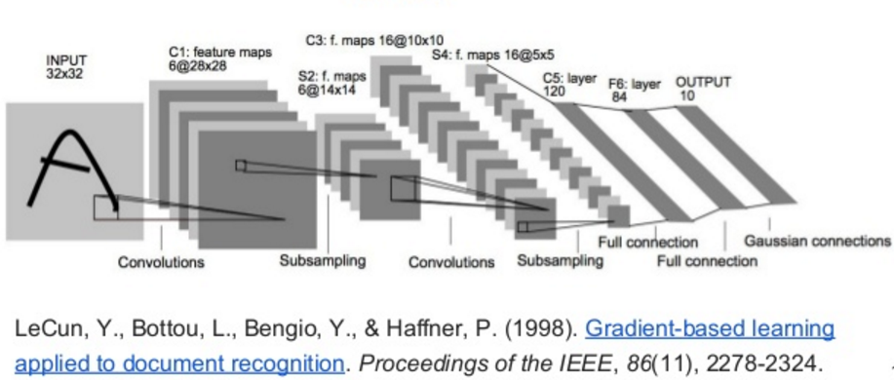
Convolutional Networks

Slide 5
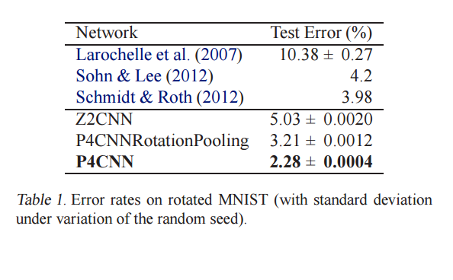
Results of GCNN
Cohen et al., M. Group equivariant convolutional networks. Proceedings of ICML, 2016.

Slide 6
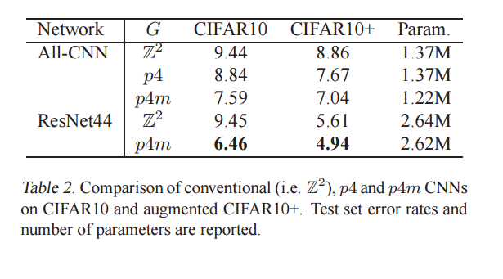
Results of GCNN
Cohen et al., M. Group equivariant convolutional networks. Proceedings of ICML, 2016.

Slide 7
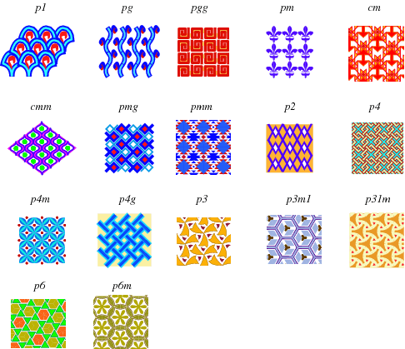
Wallpaper Groups
Source: http://mathworld.wolfram.com/WallpaperGroups.html

Slide 8
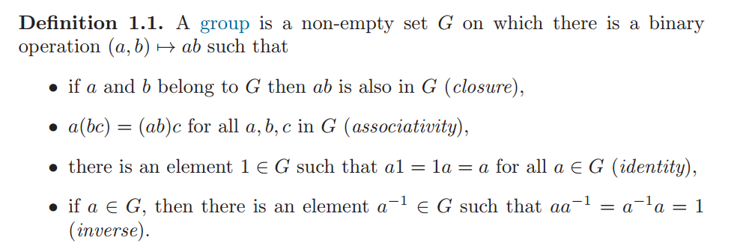
Group

Slide 9
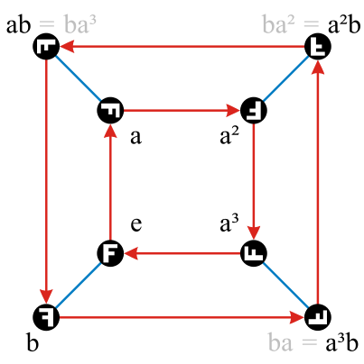
Cayley Graph
Cayley graph of the dihedral group $D_{4}$ on two generators a and b

Slide 10
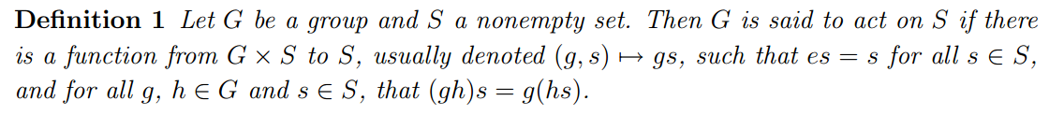
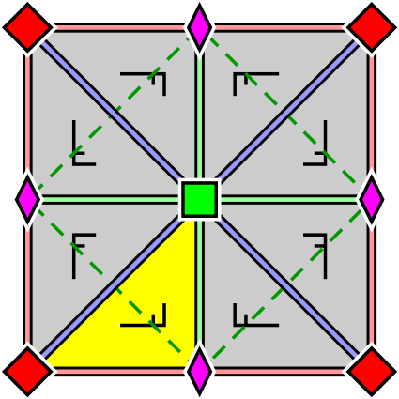
Group Action

Slide 11
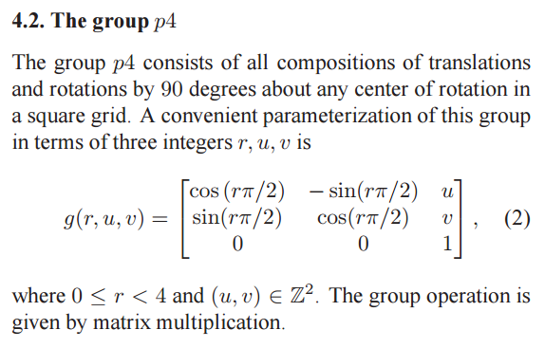
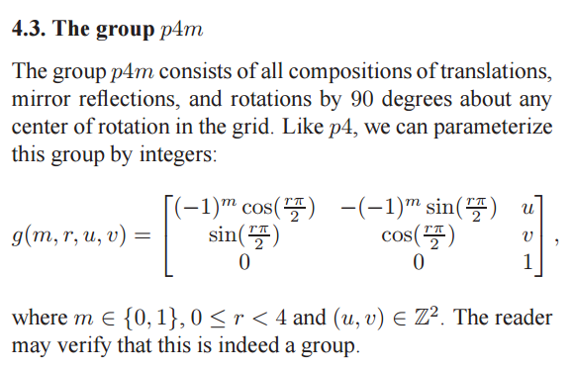
Linear Representation
A linear representation of a group G is a group action of G on a vector space V by invertible linear maps.
Cohen et al., M. Group equivariant convolutional networks. Proceedings of ICML, 2016.

Slide 12
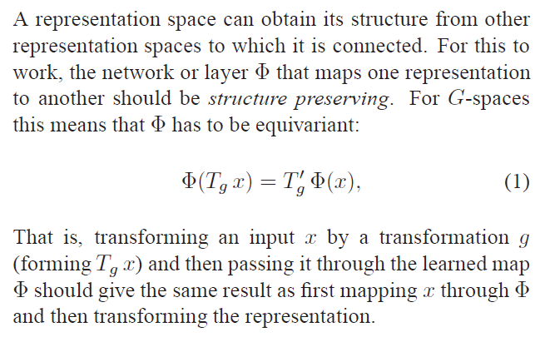
Equivariance
Cohen et al., M. Group equivariant convolutional networks. Proceedings of ICML, 2016.

Slide 13
Let’s go through the paper

Slide 14
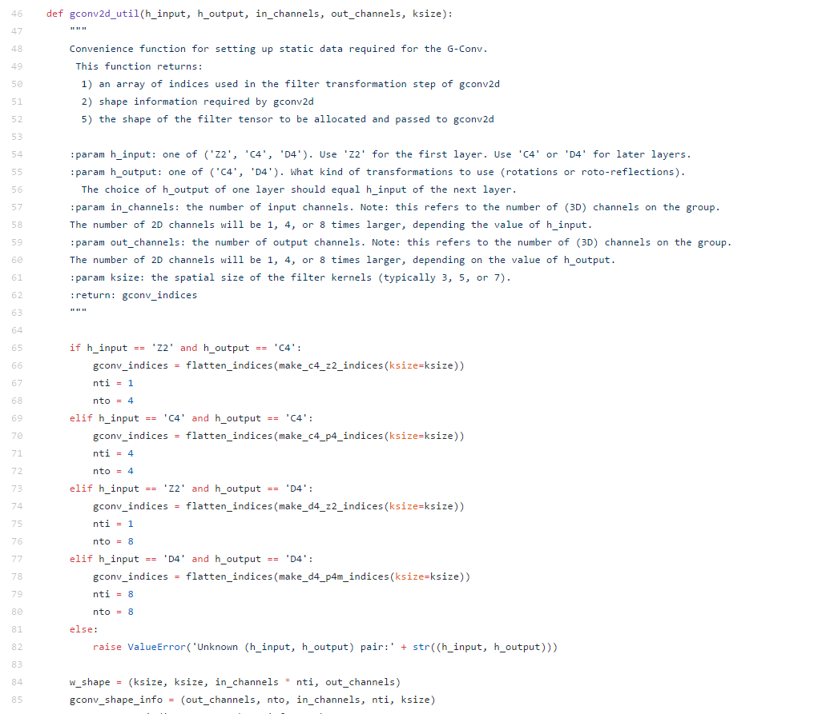
Codes
Source: https://github.com/tscohen/GrouPy/blob/master/groupy/gconv/tensorflow_gconv/splitgconv2d.py

Slide 15
Our Experiments – MNIST-Fashion

Slide 16
Our Experiments – CIFAR-10

Slide 17
Our Experiments – CIFAR-100

Slide 18
More of TS Cohen’s Work
Studies of equivariance from other authors:
Equivariance Through Parameter-Sharing
On the Generalization of Equivariance and Convolution in Neural Networks to the Action of Compact Groups
Understanding image representations by measuring their equivariance and equivalence

